Slide 1
Perspectives on work in the continuing care sector during and after the COVID-19 pandemic: A Pilot Study of Nursing Students Dr. David Rudoler, Dr. Janet McCabe, Dr. Winnie Sun, Lindsay Guest, Chase O’Halloran, Maryam Rana

Slide 2
Challenges & Purpose
Improving the recruitment and retention of registered nurses and healthcare workers in the continuing care sector is critical to ensuring adequate care for older adults, particularly following the COVID-19 pandemic.
The purpose of this study was to understand the perceptions that prospective registered nurses have about working in the continuing care sector and identify workplace attributes that attract prospective nurses to the sector.

Slide 3
Research Questions
What are the major concerns of prospective nurses about working in the continuing care sector during and after the COVID-19 pandemic?
What workplace attributes are most likely to attract prospective nurses to the continuing care sector?

Slide 4
Methods
A partially mixed and sequential mixed methods study was conducted with nursing students at Ontario Tech University.
Phase I: Focus Group Interviews
Phase II: Cross-sectional Online Survey

Slide 5
Phase 1: Focus Groups
A semi-structured interview guide was used to conduct the focus groups in the Fall semester of 2021.
Focus groups (n=14) asked students to comment on views about working in the continuing care sector, and job attributes that may attract them to the sector.
Focus group data was analysed using thematic analysis.

Slide 6
Phase II: Survey
An online cross-sectional survey was used to collect self-reported data from students in the Nursing Program during the Fall 2022 semester.
The survey consisted of two parts:
demographic information
a series of job offer scenarios; each scenario containing three different potential job offers. Each job offer consisted of attributes informed by the focus group interviews (e.g. hourly wage, vacation time, risk of injury, etc).
The survey data (n=139) was analysed using least absolute deviations estimator. Willingness-to-pay (WTP) values of wages gained or forgone were generated for each job attribute.

Slide 7
Results: Focus Groups
Important themes that emerged:
Workplace attributes that support recruitment
Workplace attributes that support retention
Perceived risks and fears related to work in the continuing care sector
Focus group interviews suggested the following were important job attributes:
Fair wage compensation
optimal client-to-staff ratios
unionized work environments
comprehensive benefits packages
flexible work arrangements

Slide 8
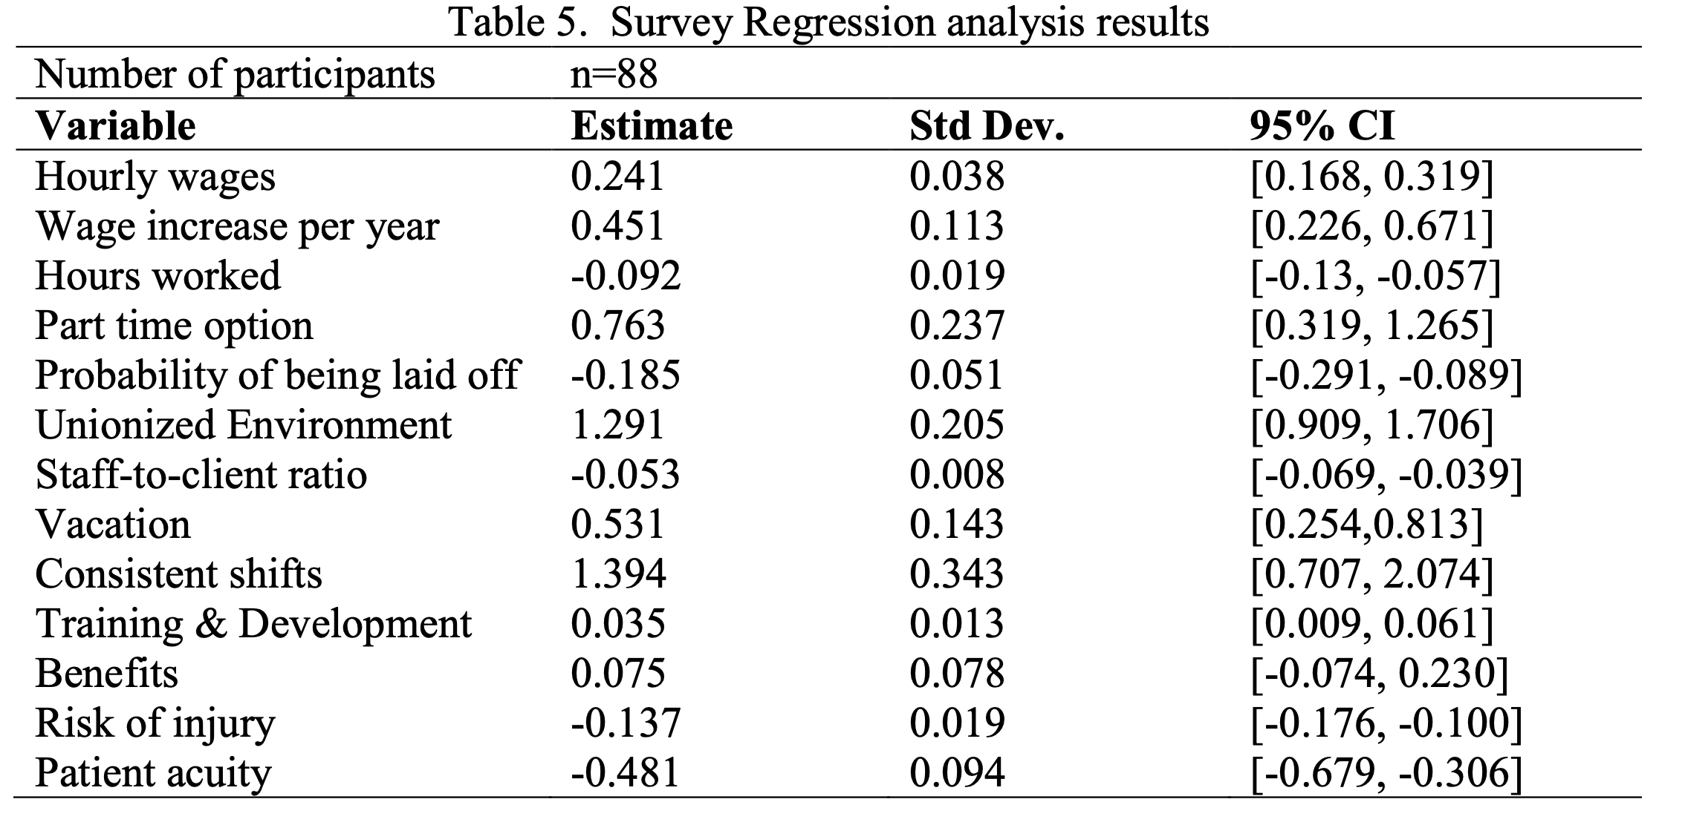
Results: Survey
18.0% expressed interest in working in continuing care sector compared to 75.5% in acute care
Regression analysis suggested all attributes were associated with work in the continuing care sector.
Two attributes had consistent willingness to pay (WTP) estimates:
higher amounts of paid vacation (WTP: -5.983; 95% CI: -13.749, -0.037)
higher risk of injury (WTP: 0.684; 95% CI: 0.124, 1.208)

Slide 9
Conclusion
Continuing care workplaces can attract nurses by offering flexible options like part-time positions and paid vacation, and by actions that reduce the risk of workplace injury, violence, and abuse.
Nursing students should be shown the positive aspects of working with older adults and dispel negative perceptions about the continuing care sector.

Slide 10
Thank You David Rudoler, PhD david.rudoler@ontariotechu.ca

Slide 11
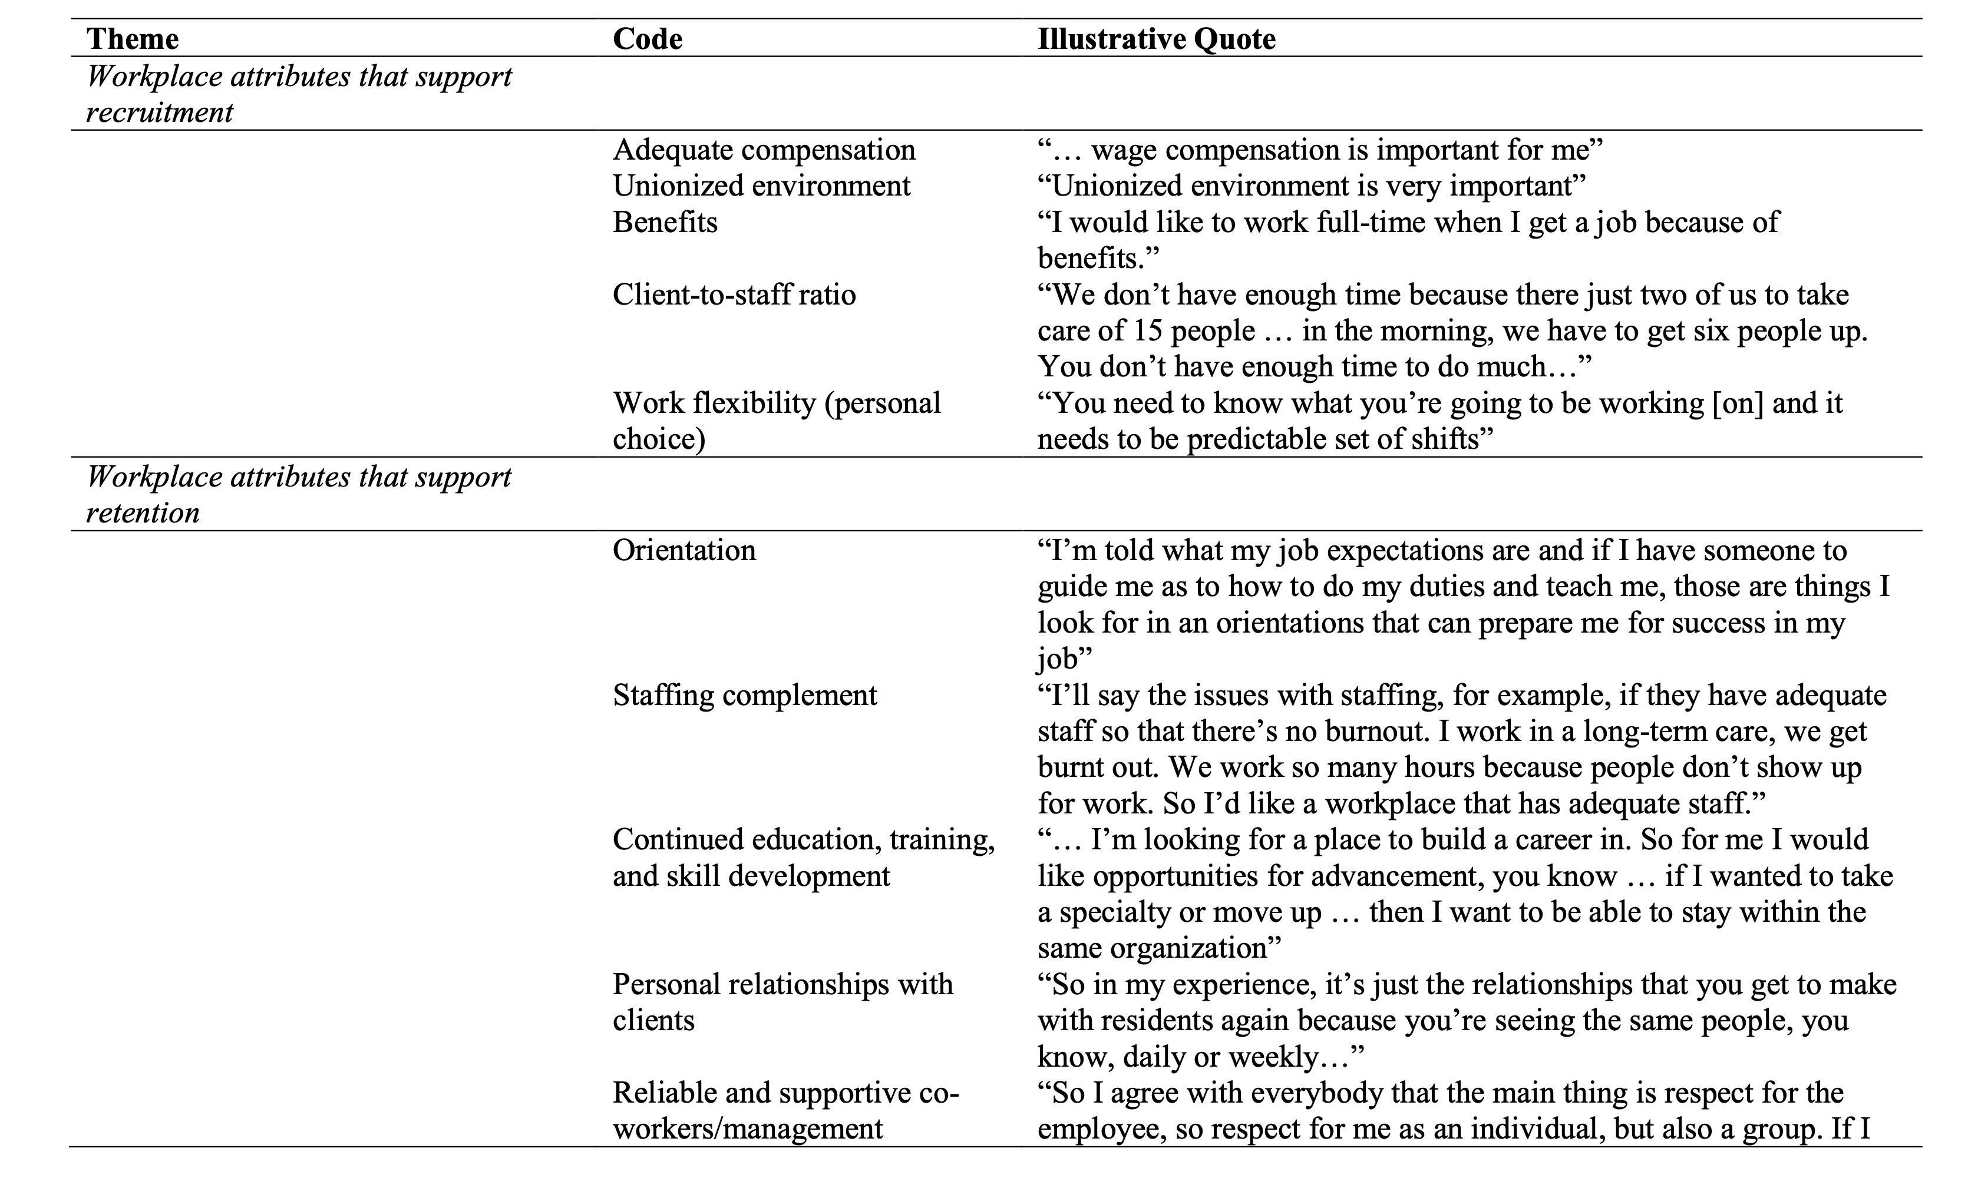

Slide 12
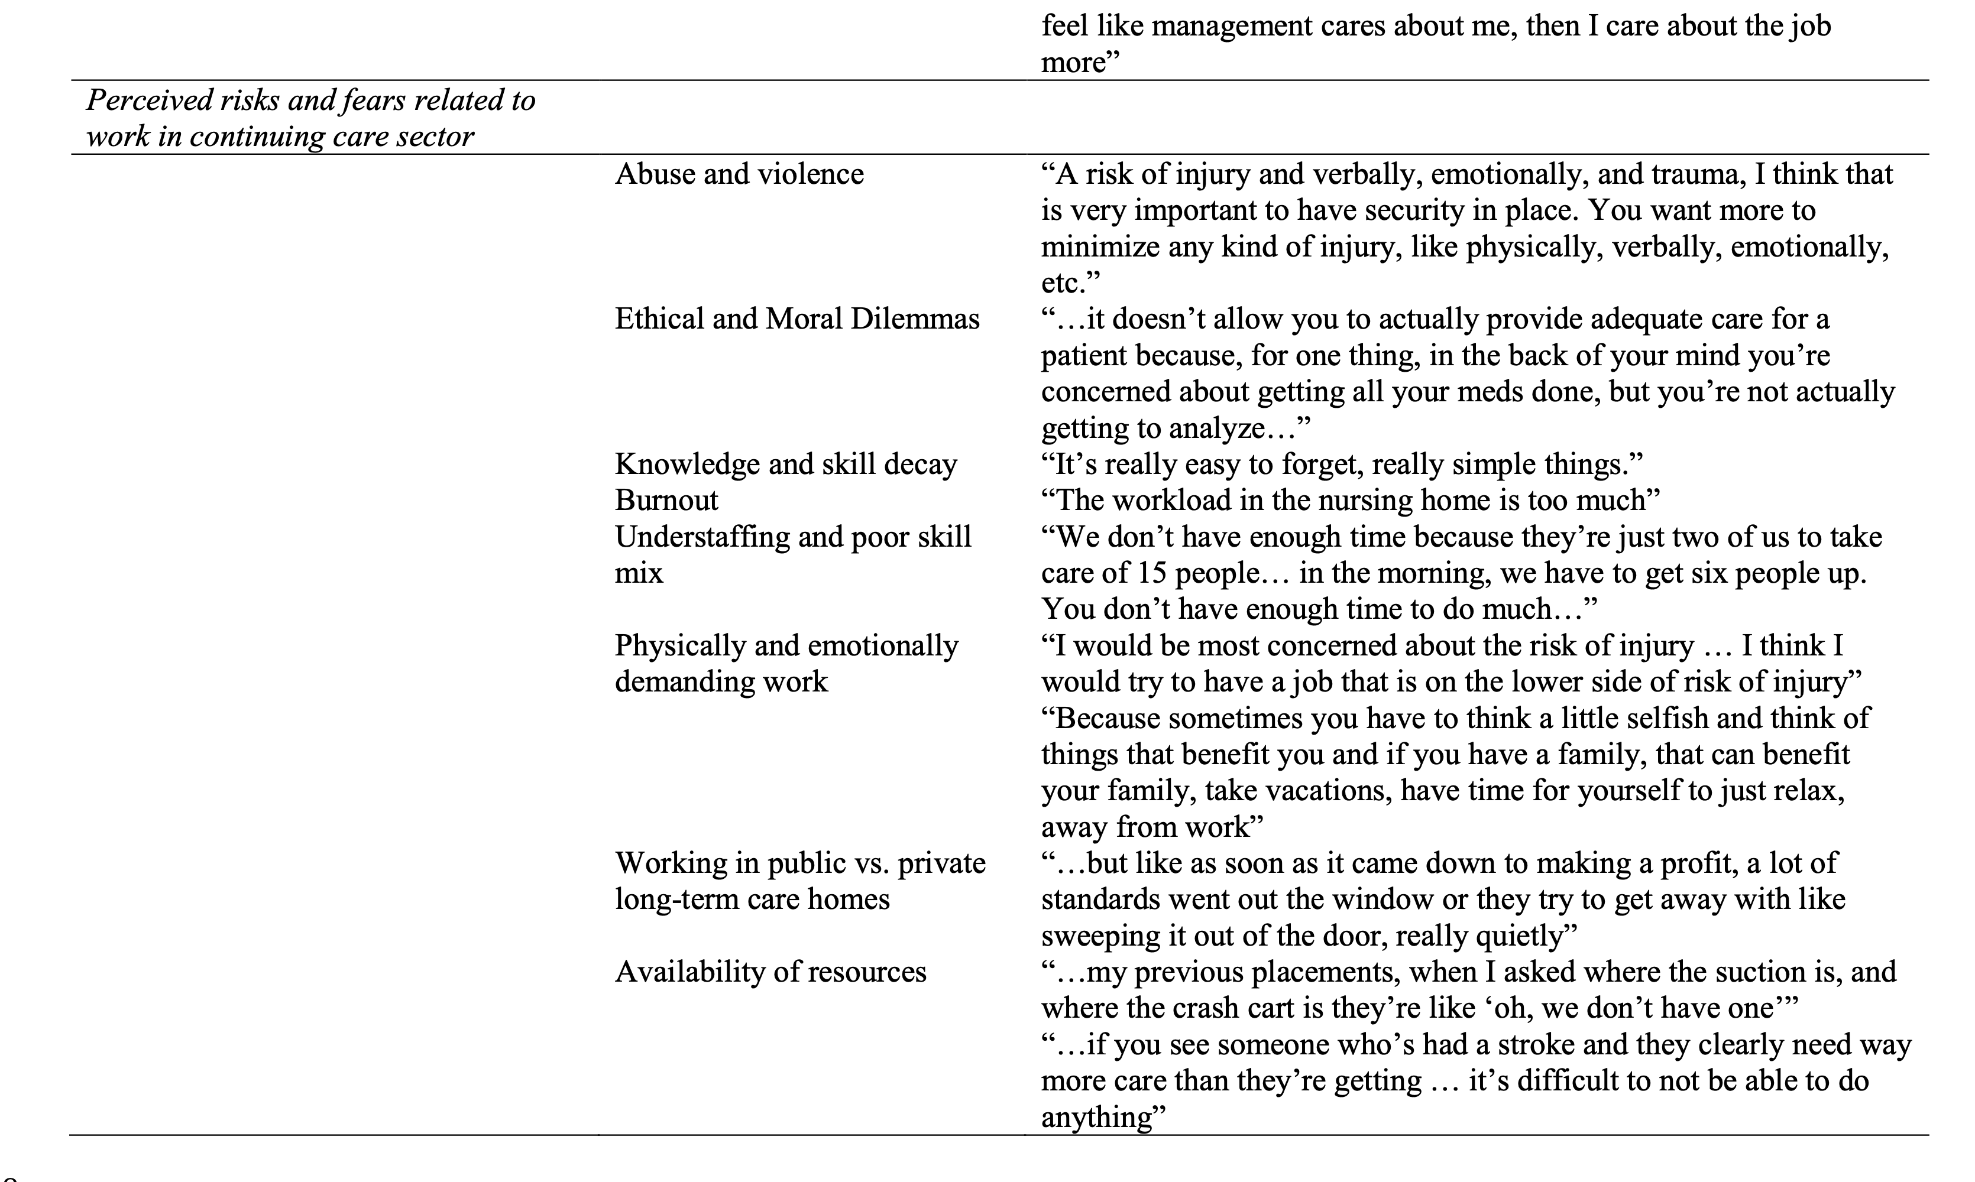

Slide 13
